Slide 1
Emerging Technology Challenge Workshop 2024 INTRODUCTION
Welcome !
19-20 March 2024

Slide 2
Housekeeping at The Cosener’s House
If you hear the fire alarm…
Make your way out of the nearest fire exit…
…to the fire assembly point at the far end of the lawn behind the main house.
First Aid Dial 2000 on the phone provided
or call 0123 55 231 98
Your nearest First Aid box is located in Reception

Slide 3
CEOI Objectives
delivers the UKSA’s Earth Observation Technology Development Programme
The CEOI seeks to:
Stimulate the development of satellite Earth Observation instrumentation in the UK;
Strengthening the national EO sector;
Helping UK businesses win global market opportunities.
Established in 2007
Q1 2023: the original consortium of the CEOI was awarded the (current) phase of the UKSA Earth Observation Technology Programme, running to March 2025.

Slide 4
What we do…
2. Foster knowledge exchange within the community, and support skills development
1. Distribute
grant funding to UK industry, research organisations & academia for the development of EO instrumentation technology
3. Support UK Business Development

Slide 5
Who we are
Delivered by a consortium of academic and industrial partners:
Chris Brownsword
Dr Nicolas Leveque
Dr Kevin Smith and Dr Jane Hurley, with support from Dr Rob Scott
Dr Joshua Vande Hey, Paul Corazzo and Nicola Oldham
The CEOI team has been expanded to include:
Amanda Regan (Butterfly Speaking and Coaching), formerly of ESA Future EO Division and InCubed Programme.
Chris Dorn (Inverse Quanta Ltd), an experienced space project manager, formerly of QinetiQ.
Will Lecky, a space economist, co-founder of know.space Ltd.

Slide 6
Programme activities to date
Completed the CEOI 15th Call and initiated the projects (2 Flagships, 6 Fast-Tracks, 2 Pathfinders)
Completed the Short-term EO Technology Preparation and Facility Enhancements Call (2 TRL raising, 3 Facility enhancement)
Undertaken an Earth Explorer 12 Support Call (2 Projects awards, short term Pathfinder size interventions)
Conducted an Earth Observation Mission Capability Review
Completed the CEOI 16th Call and initiated the projects (6 Flagships, 4 Fast-Tracks, 2 Pathfinders)
£2.48M
£0.55M
£0.18M
£9.0M

Slide 7
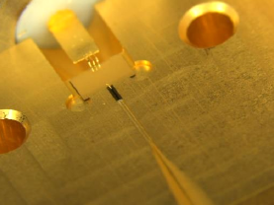
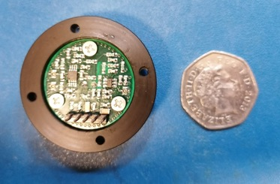
Coming up this year…
Knowledge Exchange Workshops
Specific to technologies (Lidar, Radar, Microwave & THz, advanced optics) and/or applications
Include the manufacturing & supply chain.
What are the strengths & weaknesses in the UK
Network and generate ideas (and future CEOI projects?)
Business Plan Workshop(s)
Helping you raise funding to develop your technology and set it on a path to space
Online and face-to-face
Technology Programme
Another Call is not currently planned for FY2024-25
But a small call for small projects cannot be excluded later this year
Preparations are on-going for a hypothetical call in the following financial year
Credits: Rutherford Appleton Laboratory & University of Leeds
Credits: UCL-MSSL

Slide 8
Emerging Technology Challenge Workshop 2024
Objectives:
Look to the technologies that we will be using in the near and mid-term future;
Also look at role of CEOI in a changing landscape
Detectors, Lidar and Advanced Optics
Challenges & CEOI future;
How do I fund my mission?
ESA Perspectives;
Quantum Techniques;
New Imaging Techniques
New Payloads and Missions;
Other technologies
Tuesday
Wednesday

Slide 9
Discuss ! Contribute ! Enjoy !

Slide 10
[Document Control]
Version | Comments | Date | Author
1.0 | Based on previous CEOI KO presentations | 18/03/2024 | NL

