Slide 1
TRL
Lessons from CubeMAP
Will Grainger, RAL Space
19 April 2024

Slide 2
Contents
Introduction to TRL
Brief History of CubeMAP
Brief summary of CubeMAP mission
HSDI example
  Assessment
  Development plan
Recommendations

Slide 3
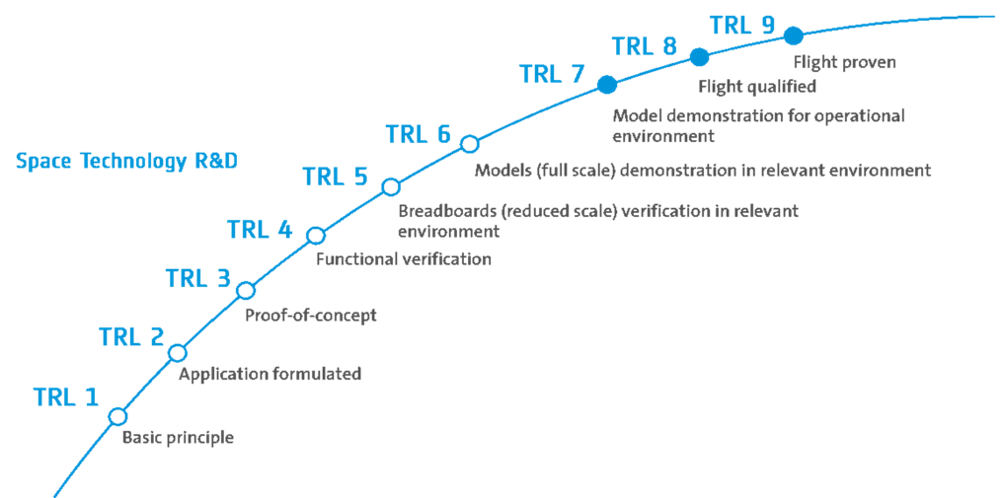
TRL - introduction
Technology readiness levels
Getting higher TRL is a risk reduction activity
ESA prefers high TRL for larger missions (eg Sentinels)
“Relevant environment” hides a lot of detail!
NewSpace has a higher risk appetite

Slide 4
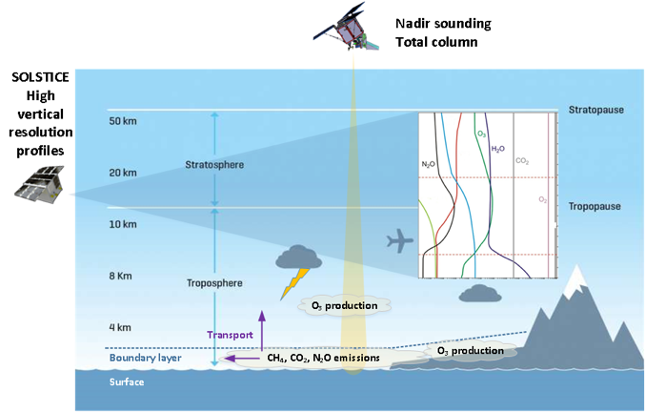
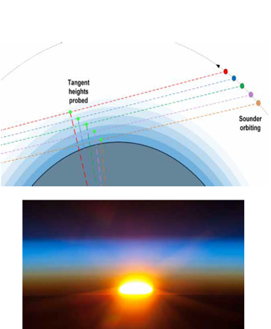
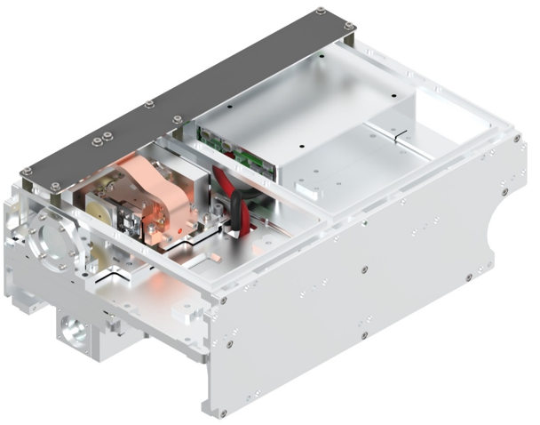
CubeMAP summary
3 12U satellites, in a ~480km high orbit, performing observations of atmospheric chemistry by limb sounding
Collaboration between GomSpace (platform provider), RAL Space (payload provider)

Slide 5
Brief history of CubeMAP
Many years of development in spectroscopy group to develop Laser Heterodyne Radiometer technique.
ESA call (SCOUT programme)
  Scout Mission Concept and system Consolidation Studies; KO November2019
    6 month study
    Was called ESP-MACS (Earth Science Processes Monitored in the Atmosphere by a Constellation of Small Satellites)
    TRL 4 at start
  Implementation; submitted May 2021, intending for 2023 launch
  Concept to take a low TRL concept to flight, as a service.
  Lots of development. Predicted launch slip and cost overruns; project cancelled April 2023

Slide 6
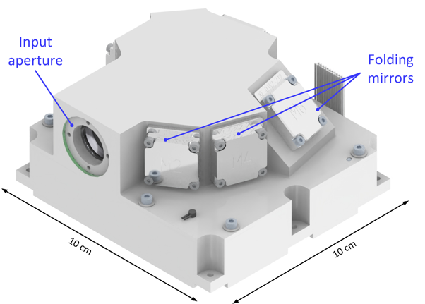
TRL assessment – what happened
HSDI example
HSDI (Hyper spectral Solar Disk Imager) is part of the CubeMAP payload.
16-channel imager operating in the visible / near infrared.
CMV2000 CMOS sensor, from IMEC
(who apply the filter)
FPGA to control sensor, communicate over
spacewire
Sensor is previously flown technology, so
considered “high TRL”; i.e. declare sensor TRL 9
FPGAs have been flown before, so considered “high TRL”…
So, HSDI instrument is high TRL right?

Slide 7
TRL assessment – what happened
HSDI example
HSDI (Hyper spectral Solar Disk Imager) is part of the CubeMAP payload.
16-channel imager operating in the visible / near infrared.
CMV2000 CMOS sensor, from IMEC
(who apply the filter)
FPGA to control sensor, communicate over
spacewire
Sensor is previously flown technology, so
considered “high TRL”; i.e. declare sensor TRL 9
FPGAs have been flown before, so considered “high TRL”…
So, HSDI instrument is high TRL right? Wrong!

Slide 8
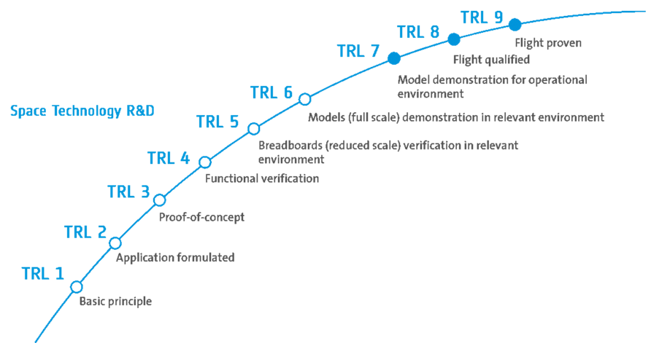
There is a difference between TRL for a component in flight and the same component in a different subsystem in a different mission
  Launch loads may be different
  Thermal environment may be different
  Biasing conditions (for electronics) will probably be different
  EMC conditions may be different
  Radiation environment may be different
  The process producing the component may be different

Slide 9
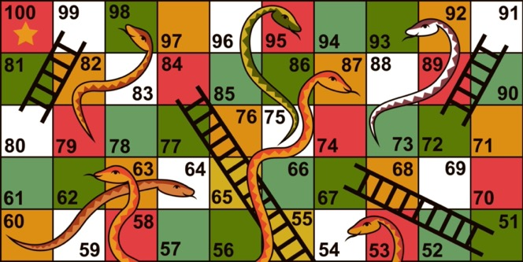
There is a difference between TRL for a component in flight and the same component in a different subsystem in a different mission
  Launch loads may be different
  Thermal environment may be different
  Biasing conditions (for electronics) will probably be different
  EMC conditions may be different
  Radiation environment may be different
  The process producing the component may be different

Slide 10


HSDI Approach: Instrument level qualification
RAL performed TRL assessment
RAL proposed a development plan + tests
RAL proposed a component selection plan
Our qualification process was to perform “instrument level” testing
  Design and build instrument
  Perform environmental tests (vibe/shock/TVAC)
  EMC by compatibility with platform
  We planned for “whole board” radiation testing
  Declare whole unit “qualified”
  Determining levels for (eg) vibe was difficult
    Uncertainty in the transfer function from launch vehicle, through launch pod, through platform structure, to instrument.
    Compared prediction with NASA GEVS levels; tested to the higher level
Different to ESA’s electronic component qualification process!
Cheaper (as less tests to do)
Carry more risk later into programme
Can’t do reliability/availability analysis
“COTS” and “New Space” are not well defined quality levels, but people talk about them as if they are.
Component selection plan details them and allows both proposers and agencies to assess plans with more knowledge

Slide 11
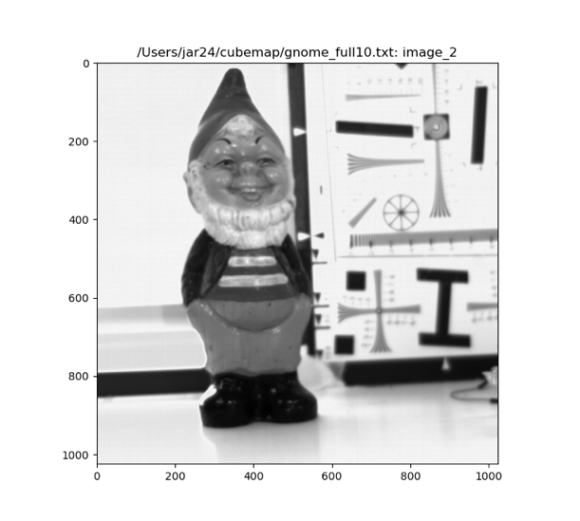
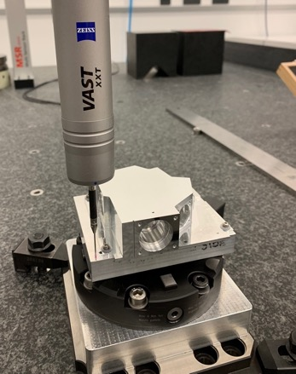
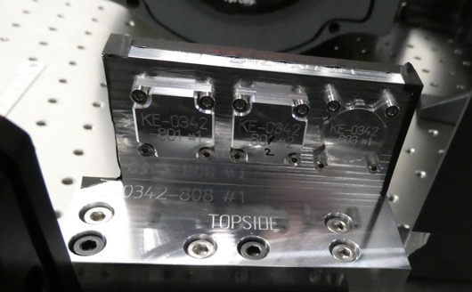
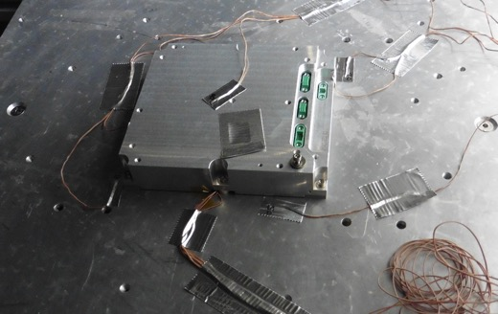
HSDI current status
First light for electronics + sensor in May 2023
Breadboard mirrors have been produced, and characterised
Breadboard Electronics has undergone TVAC
Breadboard optics “lid” in production, about to undergo vibe/shock (in combination with electronics)
Electronics has been redesigned to be single board (rather than 2 stacked boards)

Slide 12
Recommendations for planning work
Avoid over-hyping a TRL level
  Realistic assessment allows for a realistic development plan
There is a difference between TRL for components in flight, and same component in a different subsystem/mission
  Plan/cost accordingly!
Don’t try and raise TRL too quickly
  Multiple smaller proposals rather than one big “lets fly this idea” proposal
Recommendations for agencies
Ask for evidence of TRL assessments
Be clear about risk appetite
Require definitions for terms

