Slide 1

Satellite Quantum Accelerometers
for Atmospheric Science
Tristan Valenzuela – RAL Space/STFC

Slide 2
Quantum Technologies in Space
Earth Observation/Planetary Science
Atom Interferometers (Accelerometers)
Geodesy
  Earth & planetary interiors
Climatic Effects
  Ocean circulation & Water cycle
  Glacial movements
Earthquake monitoring
Atmospheric Science
Fundamental Physics
Atomic clocks & Atom Interferometers:
Tests of the Equivalence Principle
Gravity Red Shift Measurements
Tests of General & Special Relativity
Gravity Wave detection in the mid-frequency band
Dark Mater detection
Telecommunications
Atomic clocks:
Global time reference,
High accuracy satellite navigation,
Internet synchronisation.
Optical links:
Deep space ranging & communications
Increased spectral efficiency and data rates
Secure communications via QKD.

Slide 3
Quantum Technologies in Space
Earth Observation/Planetary Science
Atom Interferometers (Accelerometers)
Geodesy
  Earth & planetary interiors
Climatic Effects
  Ocean circulation & Water cycle
  Glacial movements
Earthquake monitoring
Atmospheric Science
Fundamental Physics
Atomic clocks & Atom Interferometers:
Tests of the Equivalence Principle
Gravity Red Shift Measurements
Tests of General & Special Relativity
Gravity Wave detection in the mid-frequency band
Dark Mater detection
Telecommunications
Atomic clocks:
Global time reference,
High accuracy satellite navigation,
Internet synchronisation.
Optical links:
Deep space ranging & communications
Increased spectral efficiency and data rates
Secure communications via QKD.

Slide 4
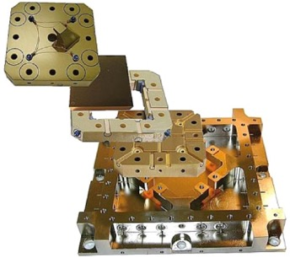
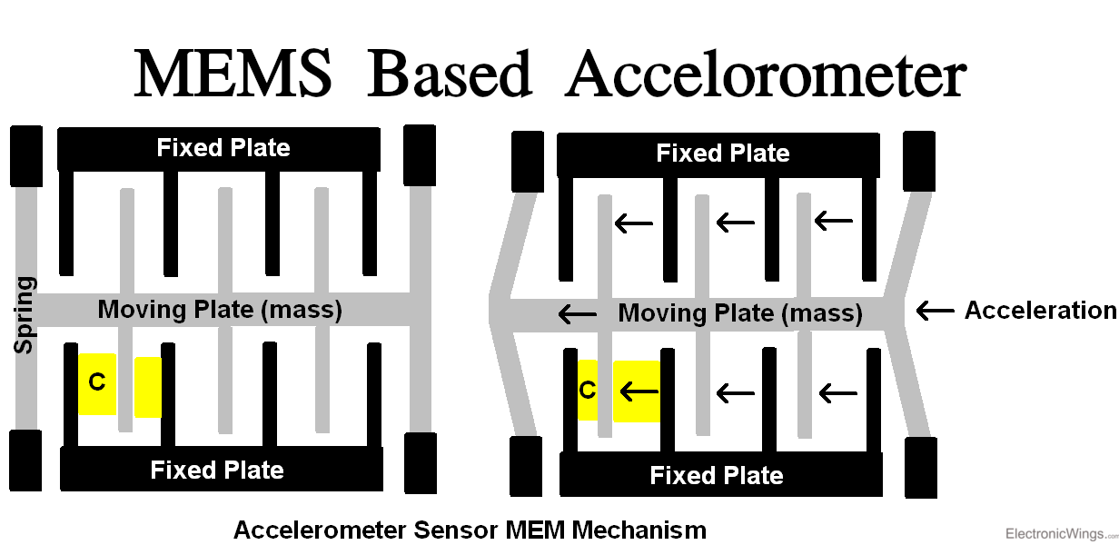
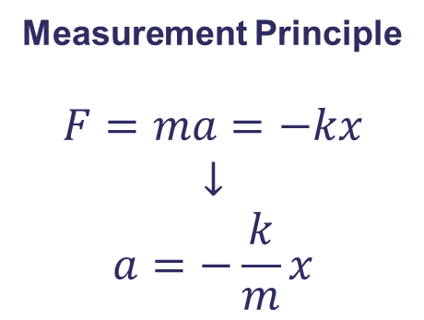
Classical accelerometers
Electrostatic Sensor
Measurement Principle
$$F=ma=−kx$$
$$↓$$
$$a=−\frac{k}{m}x$$
K Douch et al, Meas. Sci. Technol. 25 (2014) 105902
Known
Readout
Main potential problems:
“Spring” aging/noise
Release mechanism
Low frequency noise (1/f )
Main benefits:
Relatively simple
Cheap

Slide 5
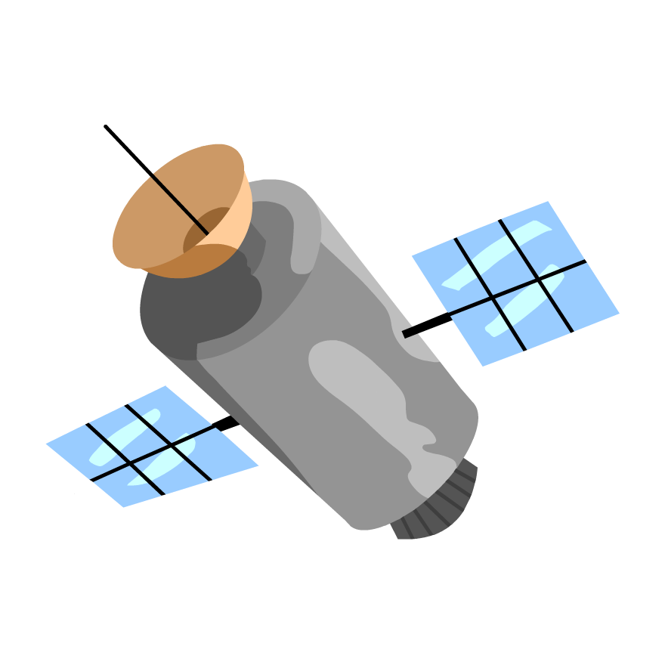
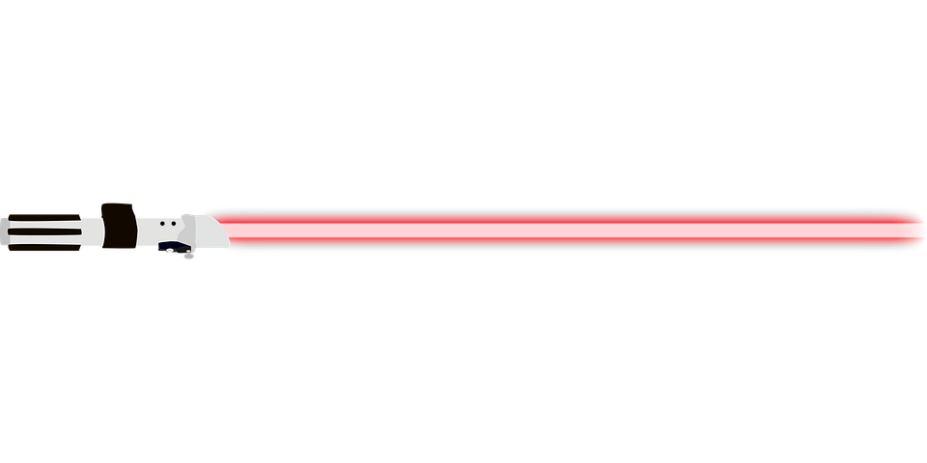
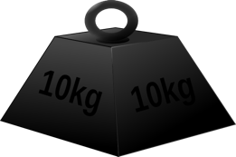
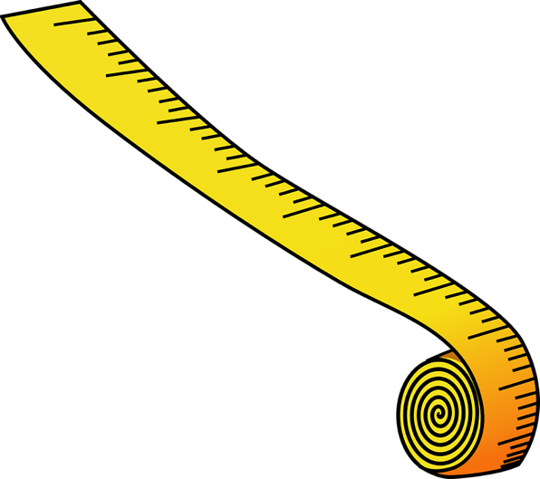


Quantum accelerometers

Slide 6
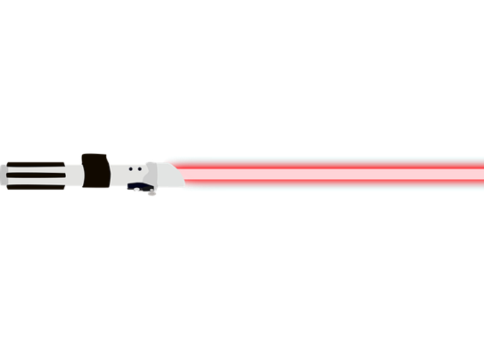
Quantum accelerometers: How?
Mach-Zehnder Interferometer
ΔΦ
I
ΔΦ

Slide 7
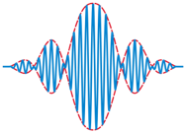

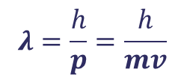
Quantum accelerometers: How?
Mach-Zehnder Interferometer
ΔΦ
I
$$λ=\frac{h}{p}=\frac{h}{mv}$$
ΔΦ
de Broglie
de Broglie, Ann. Phys. 3, 32 (1925)
Electron diffraction by Davisson and Germer,
Phys. Rev. 30, 705 (1927)

Slide 8
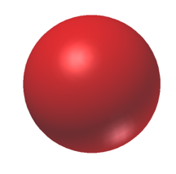
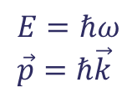
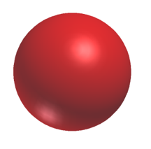



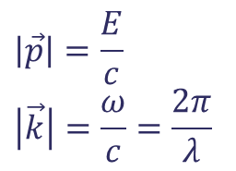


Momentum Conservation
Two level atom
$$\vec{p}=ℏ\vec{k}$$
|e⟩
$$E=ℏω \\ \vec{p}=ℏ\vec{k}$$
|g⟩
$$\left|\vec{p}\right|=\frac{E}{c}$$
$$\left|\vec{k}\right|=\frac{ω}{c}=\frac{2π}{λ}$$
|e⟩
$$ℏ\vec{k}$$
$$ℏ\vec{k}$$
|g⟩
$$\vec{p}=0$$
$$\vec{p}=−ℏ\vec{k}$$

Slide 9
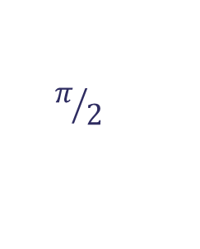

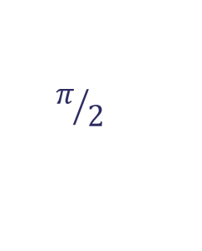

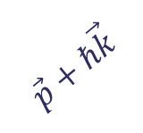
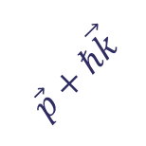


Atom Interferometer
$$π/2$$
$$π$$
$$π/2$$
space
$$\vec{p}$$
$$\vec{p}+ℏ\vec{k}$$
$$\vec{p}+ℏ\vec{k}$$
$$\vec{p}$$
$$\vec{p}$$
Preparation
Detection
0
T
2T
time

Slide 10
Atom Interferometer
$$π/2$$
$$π$$
$$π/2$$
space
$$\vec{p}$$
$$\vec{p}+ℏ\vec{k}$$
$$\vec{p}+ℏ\vec{k}$$
$$\vec{p}$$
$$\vec{p}$$
Beam Splitter
Mirror
Beam Splitter
0
T
2T
time

Slide 11
Atom Interferometer
0
T
2T

Slide 12
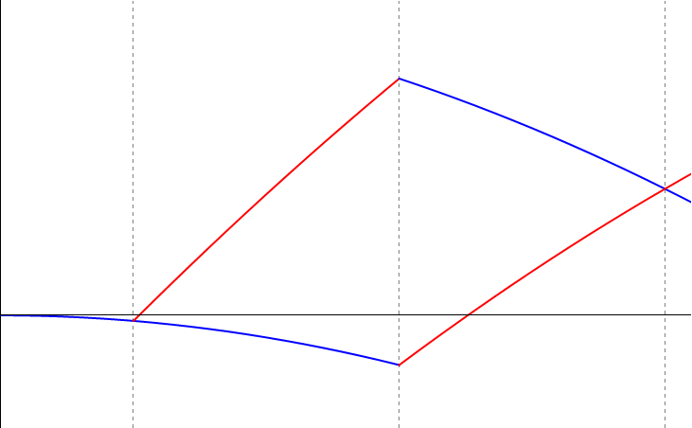
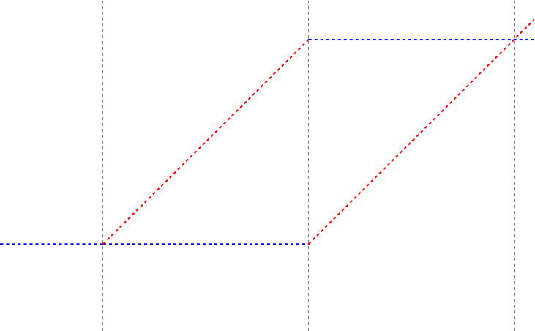


Atom Interferometer
$$\vec{a}$$
$$Δφ=\vec{k}∙\vec{a}{ T}^{2}$$
0
T
2T

Slide 13
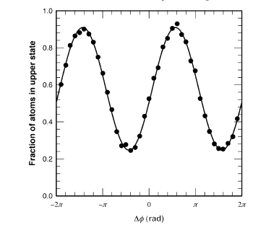
Measurement Example
A. Peters, et al. Phil. Trans. R. Soc. Lond. A 355, 2223 (1997).

Slide 14
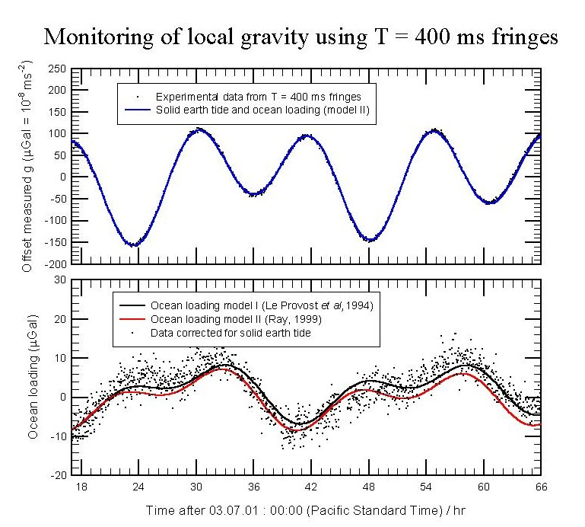
Measurement Example
1μGal=10⁻⁸ m/s²~10⁻⁹g
A. Peters, et al. Phil. Trans. R. Soc. Lond. A 355, 2223 (1997).

Slide 15
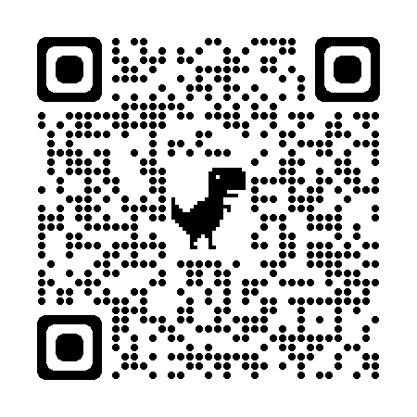
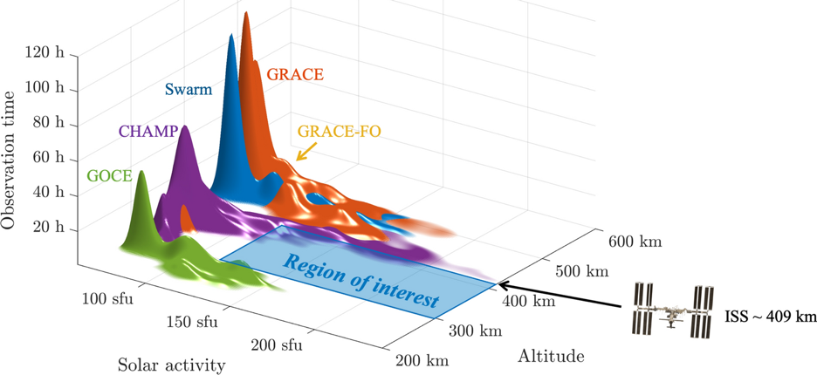
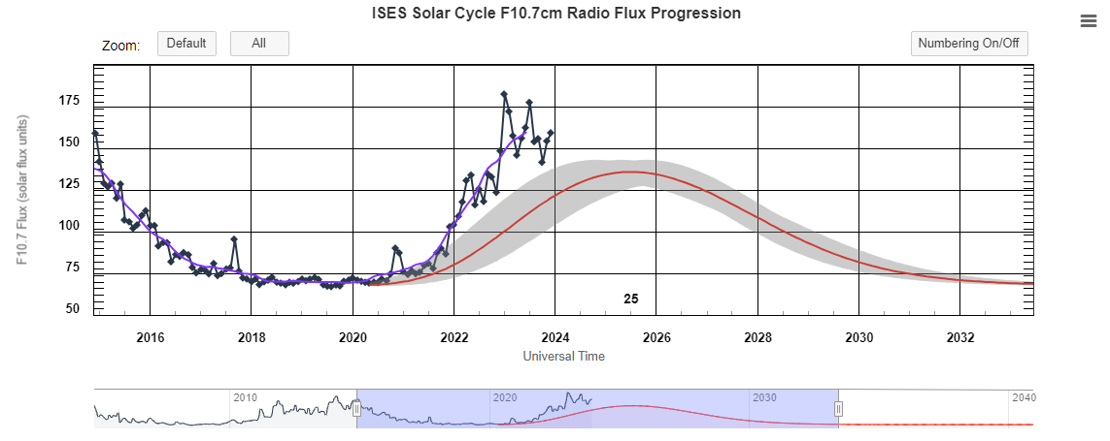

Proposed mission
CAITDM
Cold Atom Interferometric
Thermosphere Drag Measurement
Siemes, C., Maddox, S., Carraz, O. et al. CEAS Space J 14, 637–653 (2022).
https://doi.org/10.1007/s12567-021-00412-1
Image © STFC RAL Space
NOAA Space Weather Prediction Center
https://www.swpc.noaa.gov/products/solar-cycle-progression
Notes:
Solar cycle data from https://www.swpc.noaa.gov/products/solar-cycle-progression#:~:text=The%20Prediction%20Panel%20predicted%20Cycle,November%202024%20and%20March%202026.

Slide 16
Proposed mission
CAITDM
Cold Atom Interferometric
Thermosphere Drag Measurement
Aim:
Raise the TRL of critical subsystems
towards an AI accelerometer instrument
Siemes, C., Maddox, S., Carraz, O. et al. CEAS Space J 14, 637–653 (2022).
https://doi.org/10.1007/s12567-021-00412-1
Means:
Build a representative breadboard of the instrument and perform env. tests of selected subsystems
Image © STFC RAL Space
NOAA Space Weather Prediction Center
https://www.swpc.noaa.gov/products/solar-cycle-progression
Notes:
Solar cycle data from https://www.swpc.noaa.gov/products/solar-cycle-progression#:~:text=The%20Prediction%20Panel%20predicted%20Cycle,November%202024%20and%20March%202026.

Slide 17
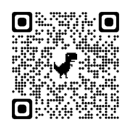

Proposed mission
CAITDM
Cold Atom Interferometric
Thermosphere Drag Measurement
Typical densities @400km $\sim 4−10× {10}^{−15} \text{g}\text{/}\text{c}{\text{m}}^{\text{3}}$
some peaks exceed $15×{10}^{−15} \text{g}\text{/}\text{c}{\text{m}}^{\text{3}}$
Siemes, C., Maddox, S., Carraz, O. et al. CEAS Space J 14, 637–653 (2022).
https://doi.org/10.1007/s12567-021-00412-1
e.g. Forbes, J. M., G. Lu, S. Bruinsma, S. Nerem, and X. Zhang (2005),
J. Geophys. Res., 110, A12S27, https://doi.org/10.1029/2004JA010856
Image © STFC RAL Space
NOAA Space Weather Prediction Center
https://www.swpc.noaa.gov/products/solar-cycle-progression
Notes:
Solar cycle data from https://www.swpc.noaa.gov/products/solar-cycle-progression#:~:text=The%20Prediction%20Panel%20predicted%20Cycle,November%202024%20and%20March%202026.

Slide 18
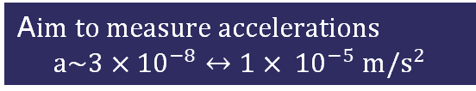
Proposed mission
CAITDM
Cold Atom Interferometric
Thermosphere Drag Measurement
Typical densities @400km $\sim 4−10× {10}^{−15} \text{g}\text{/}\text{c}{\text{m}}^{\text{3}}$
some peaks exceed $15×{10}^{−15} \text{g}\text{/}\text{c}{\text{m}}^{\text{3}}$
Siemes, C., Maddox, S., Carraz, O. et al. CEAS Space J 14, 637–653 (2022).
https://doi.org/10.1007/s12567-021-00412-1
e.g. Forbes, J. M., G. Lu, S. Bruinsma, S. Nerem, and X. Zhang (2005),
J. Geophys. Res., 110, A12S27, https://doi.org/10.1029/2004JA010856
Image © STFC RAL Space
A$im to measure accelerations$
$$a\sim 3×{10}^{−8}↔1× {10}^{−5} m/s^{2}$$
NOAA Space Weather Prediction Center
https://www.swpc.noaa.gov/products/solar-cycle-progression
Notes:
Solar cycle data from https://www.swpc.noaa.gov/products/solar-cycle-progression#:~:text=The%20Prediction%20Panel%20predicted%20Cycle,November%202024%20and%20March%202026.

Slide 19
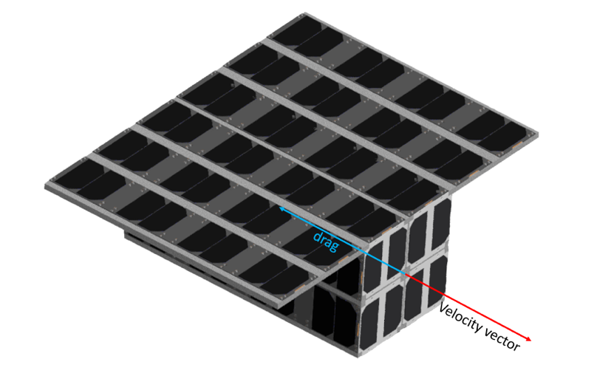
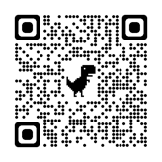
Overall Instrument Concept
16 U CubeSat
Bus +Avionics
Lasers + PL Electronics
Physics Package
Magnetic Shield
Coils
Telescopes
Vacuum Chamber
20cm x 20cm x 20cm
Ferreras, J., Spencer, J., Salter, M., Valenzuela, T., et al. Cold Atom Space Payload Atmospheric Drag Mission (CASPA-ADM). 36th Annual Small Satellite Conference, SSC22-P2-18,
https://digitalcommons.usu.edu/smallsat/2022/all2022/258/

Slide 20



Thank you
ralspace.stfc.ac.uk
@RAL_Space_STFC
RAL Space
RAL Space

