Slide 1
Kinetic Inductance Detectors (KIDs)
Kieran O’Brien
University of Durham, UK
Durham, UCSB, SRON, UKATC, JPL

Slide 2

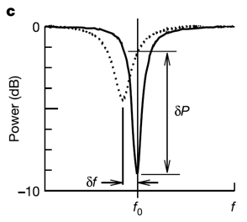
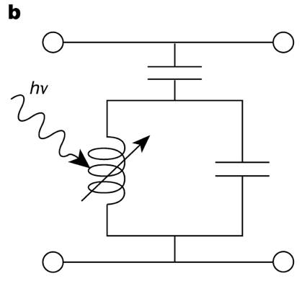
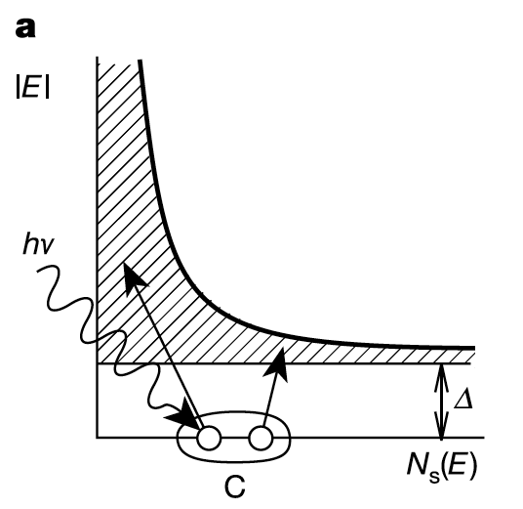
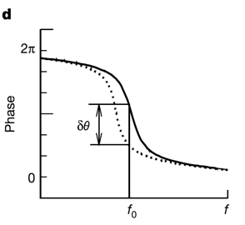
Kinetic Inductance Detectors
MKID Equivalent Circuit
Inductor is a
Superconductor!
Energy Gap
Silicon – 1.10000 eV
Aluminum – 0.00018 eV
PtSi - 0.00007 eV
Cooper Pair
Notes:
Inductance is in form of Kinetic inductance.
Kinetic Inductance = extra inductance from stored kinetic energy in Cooper Pairs
Inversely proportional to number of cooper pairs. Photon breaks pairs, thus inductance goes up and resonant frequency goes down.

Slide 3

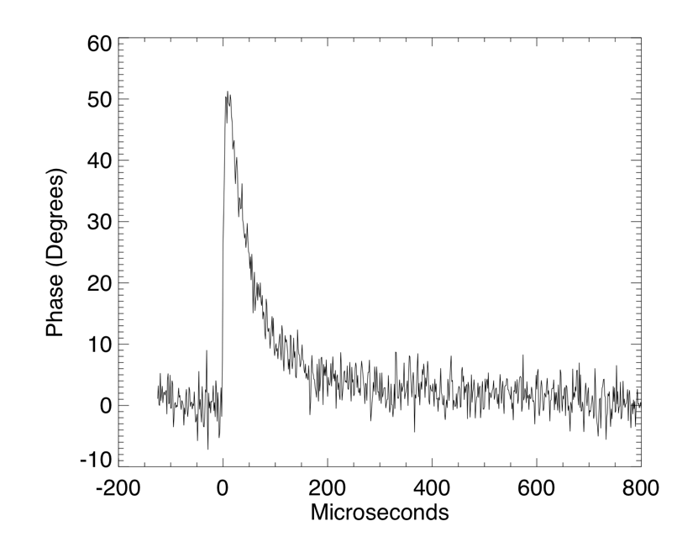

Phase-shift of probe signal
Typical Single Photon Event

Slide 4
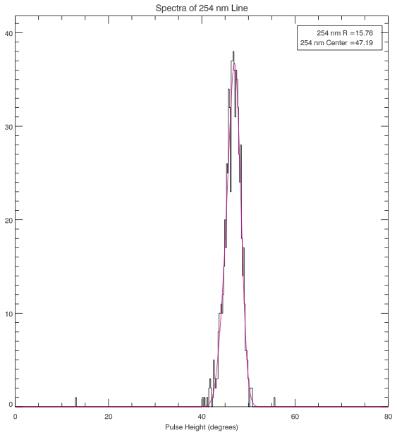
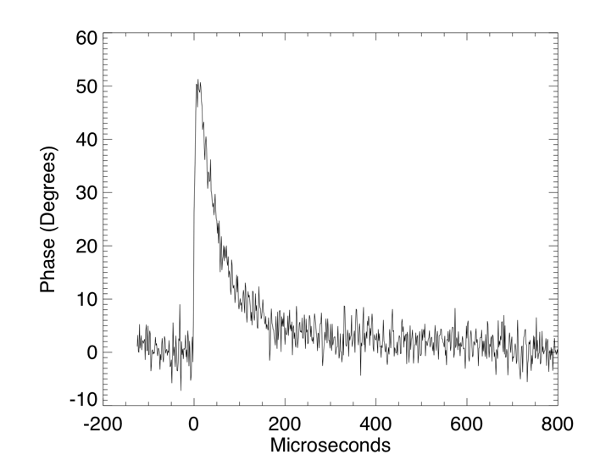
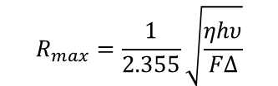

Energy resolving detector
Energy Gap
Silicon – 1.10000 eV
Aluminum – 0.00018 eV
PtSi - 0.00007 eV
$$R_{max}=\frac{1}{2.355}\sqrt{\frac{ηhυ}{FΔ}}$$
Distribution of Photon Events
hν= 3.1eV (400nm), R <~ 150 for η=0.57, F = 0.2
$$R_{meas}=\frac{E}{FWHM(E)}$$

Slide 5

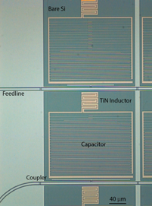
Lumped element pixels

Slide 6

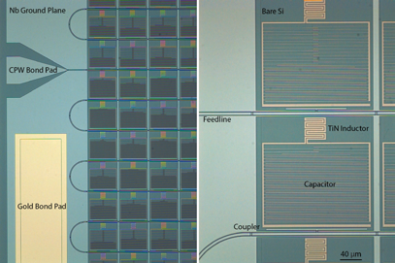
Arrays of MKIDs
Notes:
Resonators close in frequency are far apart in space

Slide 7
Digital MKID Readout
Software Defined Radio (SDR) Overview
  Leverages massive industry investment in ADCs/FPGAs
  Generate frequency comb and up-convert to frequency of interest
  Pass through MKID and amplify
  Down-convert and Digitize
  “Channelize” signals in a powerful FPGA
  Process pulses (optical/UV/X-ray) or just output time stream (sub-mm)

Slide 8
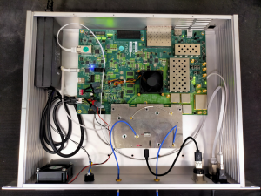
Gen-3 read-out
Uses latest Xilinx RF system-on-chip (RFSoC)
hardware that combines FPGA and ADC/DACs
  ZCU111
    ZYNQ ULTRASCALE+ FPGA
    8x 14-bit 6.5GSPS DAC
    8x 12-bit 4GSPS ADC
  Development driven by telecoms industry
Firmware similar architecture to Gen-1 & 2
Developed single-feedline hardware for mixing to 4-8GHz with UKRI-funding, now have hardware for 10,000 pixel array
Investigating firmware architectures to read-out multiple feedlines, reducing cost/pixel further
  ROACH Based readout cost ~$50/pixel used in ARCONS
  RFSoC system being deployed now is ~$5/pixel

Slide 9
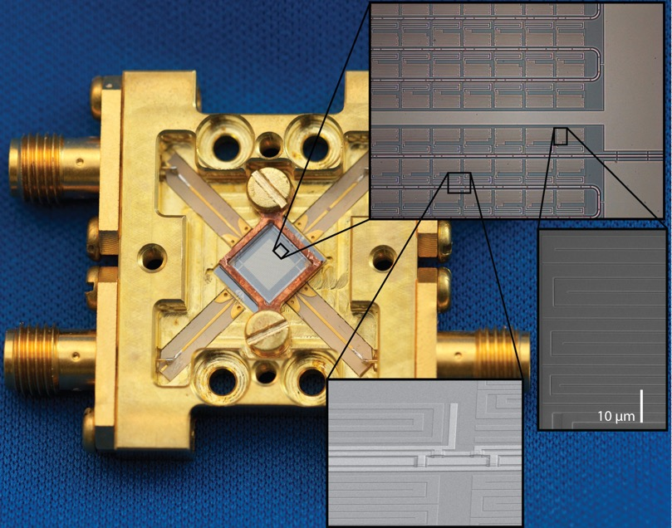
The first science array (2011)
1024 pixel array (15x larger than any previous STJ/TES array)
2 feedlines with 512 resonators/feedline
Designed to have 2MHz spacing between resonators
Resonators close in frequency are far apart in space
839 resonators found in wide sweep (82%)
669 pixels accessible by read-out (4x512MHz)
65% of total array
Mazin, et al. PASP, 123, 933
Notes:
Gradient across wafer causes shift in frequency. Position algorithm makes clumping worse!

Slide 10
Spectral response
Currently far from ‘Fano’ limit.
Typical histogram of pulse heights from calibration source
Histogram of resolution of individual resonators (pixels)
Notes:
‘Fano’ limit - fluctuation of an electric charge obtained in a detector

Slide 11
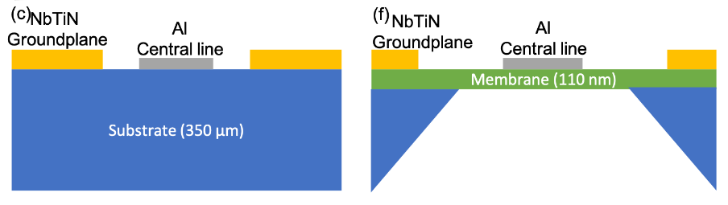
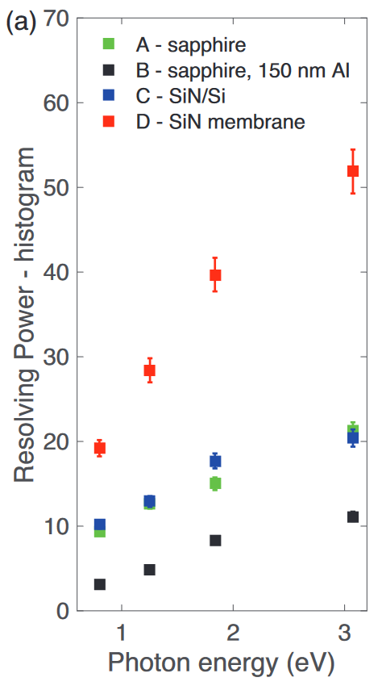
Energy resolution - I
Pieter de Visser et al, PhyRevApp, 16, 034
SRON group
NbTiN-Al Hybrid MKID
Suspended on SiN membrane
Phonons take longer to be lost to substrate, so can break more cooper pairs
Single pixel device (at the moment)
Energy resolution of ~50 at 400nm

Slide 12
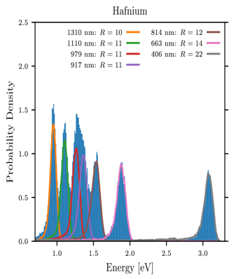
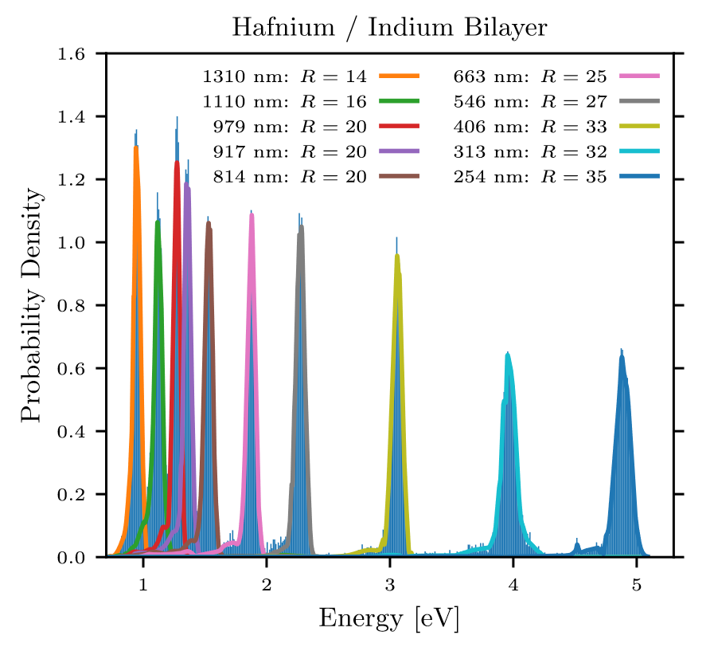
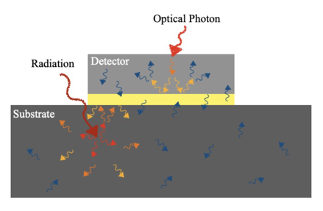
Energy resolution - II
Nick Zobrist et al., astro-ph/2204.13669
UCSB-team
Indium (yellow) beneath Hafnium (light grey) MKID
Different phonon states means they are reflected either back into detector (optical photons) or back into substrate (cosmic rays)
Easier to manufacture, especially large arrays
Energy resolution: R=33 from R=22 at 406nm
R=25 from R=14 at 663nm

Slide 13
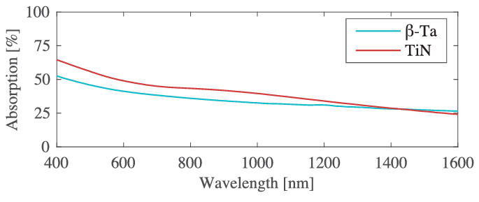
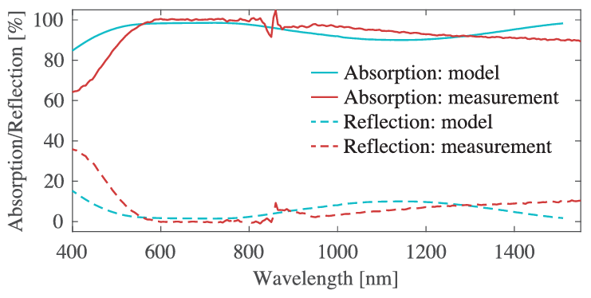
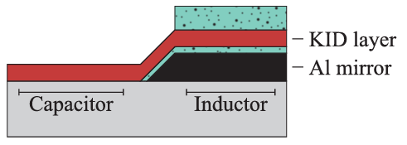
Quantum Efficiency
Metals with natural absorption of 30-50%
Simple model
  85 nm SiOx
  60 nm TiN (KID inductor)
  23 nm SiOx
  100 nm thick Al (mirror)
Needs to be demonstrated in a large array
Can be further improved with more complex dielectric stacks
-- Dielectric
Kouwenhoven, et al. JLTP, 2022

Slide 14
Instrument concepts
Classification of transients | Accretion onto compact objects | Dark matter/energy | Exoplanets | Wave-front sensing
High throughput, low spectral resolution Integral Field Spectroscopy | High time resolution and high spectral resolution single-object spectroscopy | Highly multiplexed, low spectral resolution spectroscopy | Photon-counting IFS for coronographic planet finder | High speed, low latency, zero read-noise detector
ARCONS/ KRAKENS | KIDSPEC | Mega-Z / Giga-z | ‘Darkness’ MEC | Ultra-fast WFS
Mazin, et al. PASP, 123, 933 Mazin, et al. SPIE, 107020H | O’Brien, JLTP, 199, 537 | Marsden, et al., ApJS, 208, 8 | Meeker, et al. PASP, 130, 65 Walter, et al. PASP 132, 125 | Magniez, et al., in prep

Slide 15
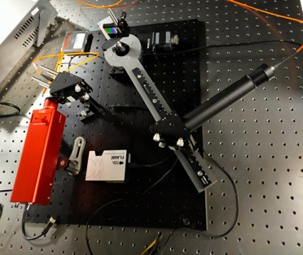
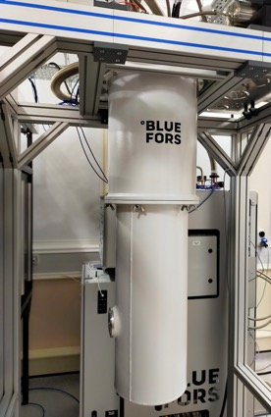
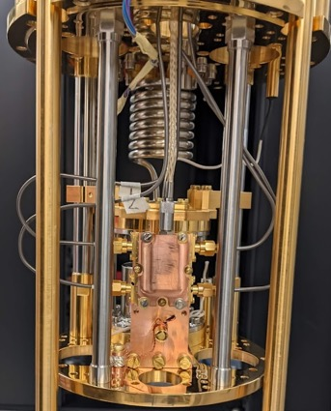
KIDSpec in the lab
R=7500 spectrograph, 0.35-1.8µm, uses KID energy resolution to ‘order sort’ an echelle grating
Key technology demonstration
All components in hand
Bluefors SD closed-cycle Dilution fridge (100mK operating temperature)
Detector package is a device from UCSB
Read-out is GEN-3 (RFSoC) system
Bench-top spectrograph will illuminate array via fiber
Instrument could be fiber-fed, or direct coupled from an optical port in side/base of cryostat

Slide 16
Detectors for astronomy
 | Sensitivity | Noise | Time resolution | Energy resolution | Array size | Cost/unit
Eyes | Poor | Good | msec | Poor | Good | Free
Photographic plates | Fair | Poor | minutes | none | Good | Moderate
Photomultipliers | Fair | Good | <μsec | none | Poor | High
CCDs (frame transfer, EMCCDs) | Excellent | Good | seconds | none | Excellent | Moderate
CMOS | Excellent | Fair | seconds | none | Excellent | Moderate
APD (SPADs, Geiger-mode, APD | Fair | Good | <μsec | none | Poor | High
STJ | Fair | Excellent | μsec | Fair | Poor | High
TES | Fair | Excellent | μsec | Fair | Poor | High
KID | Fair | Excellent | μsec | Fair | Fair | Moderate

Slide 17
Detectors for astronomy
 | Sensitivity | Noise | Time resolution | Energy resolution | Array size | Cost/unit
Eyes | Poor | Good | msec | Poor | Good | Free
Photographic plates | Fair | Poor | minutes | none | Good | Moderate
Photomultipliers | Fair | Good | <μsec | none | Poor | High
CCDs (frame transfer, EMCCDs) | Excellent | Good | seconds | none | Excellent | Moderate
CMOS | Excellent | Fair | seconds | none | Excellent | Moderate
APD (SPADs, Geiger-mode, APD | Fair | Good | <μsec | none | Poor | High
STJ | Fair | Excellent | μsec | Fair | Poor | High
TES | Fair | Excellent | μsec | Fair | Poor | High
KID (next 5 years?) | Excellent | Excellent | μsec | Good | Good | Fair

Slide 18
Summary
MKIDs for optical/IR astronomy have been successfully demonstrated on sky
Challenges remain in increasing uniformity and responsivity of arrays
Their unique scalability amongst energy sensitive detectors makes them an excellent candidate for future instrumentation
KIDspec is an extremely powerful instrument concept with a broad science case.
  0.3-1.8µm; spectral resolution ~10,000; photon-counting
MKIDs are not just for astronomy
  broad passband (0.3-2.5µm in astronomy)
  Photon counting
  Read-noise free
  Large arrays (20,000 pixels/spaxels; 400,000 voxels)
The perfect detector for a wide range of applications where every photon counts
The next step towards the ‘Ultimate Detector’?
Join the MKID revolution!

